Slide 1
Performance Engineering of Proof-Based Software Systems at Scale
Jason Gross
Ph.D. Defense
MIT CSAIL

Slide 2
What I did in my PhD
Notes:
I want to start off by telling you how I spent my time in my PhD, because I think it is perhaps in some ways a little bit atypical.
PhDs are perhaps usually thought of as being about discovering interesting new things, but in fact only about 1% of my time could be identified as being aimed at that.
About 80% --- the bulk of my time --- was spent effectively working around slowness issues in Coq, aimed at doing performance engineering.
The reason I want to tell you this is that I’m going to be structuring my talk around performance engineering, both how it works currently and how I think it needs to change.

Slide 3
Takeaways for you (TODO: better words on this slide)
Learn about my work!
Learn about my learnings!
Notes:
The things I want you to take away from this talk fall into two broad categories.
One of them is the performance engineering that I’ve done over the course of my PhD, for which I’ll be using the Fiat Cryptography project as the primary case study.
The other category of things that I want you to take away is how I see performance engineering in verification currently being done and how I think it needs to change.
(OLD:
I want to start by sharing what I want you to take away from this defense, so that you can keep an eye on that as I give my talk
The second thing I want you to take away is about what I’ve learnt about how verification is currently done, what the field of verification currently looks like, and how I see it needing to change in the future.
)

Slide 4
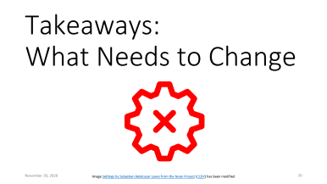
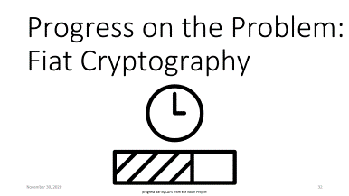
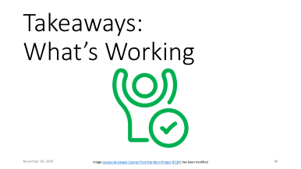

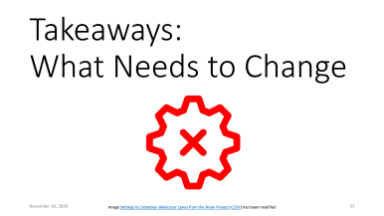

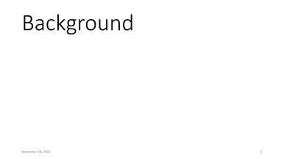

Outline
Notes:
TODO: clean up notes
Point at the problem, explain why it’s important (standing in the way of verification reaching its promise)
Note, perhaps, that no-one seems to be tackling it or even systematically investigating it --- I have more to say about this, but only have time to hint at this in the defense
Describe what current research progress towards this big problem looks like, using the particular example of the progress I've made towards it (fiat-crypto) with my colleagues during my PhD
Share what I've learnt about how this problem can currently be chipped away at with current techniques
Share what I've learnt about how the larger problem might need very different research that no-one seems to currently be doing

Slide 5


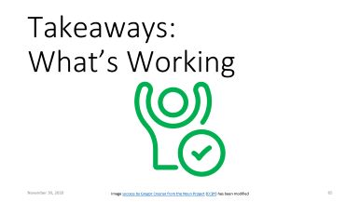

Outline

Slide 6
Background
Notes:
Let’s back up a bit and start with some background on verification.
TODO: use Bliss windows XP background???? Find a background

Slide 7



Why Verification?
Software is important
Bugs are bad
power grid by popcornarts from the Noun Project; X-ray machine by Gan Khoon Lay from the Noun Project
Train by Manaqib S from the Noun Project; Death by Adrien Coquet from the Noun Project; Dollar falling by Davo Sime from the Noun Project;
Man fail to understand blueprint by Gan Khoon Lay from the Noun Project
Notes:
Software important
Bugs bad:
People sad
Money die
People go bye-bye

Slide 8
Why Verification?
Software is important
Bugs are bad
Verification promises a fix
Notes:
(Note that I'm talking about ITPs; human help is important for difficult problems)
TODO: talk about how verification fixes things, maybe with example of unary math and binary 64-bit multiplication + modular reduction

Slide 9
Two Kinds of Bugs
Notes:
(Note that I'm talking about ITPs; human help is important for difficult problems)
TODO: talk about how verification fixes things, maybe with example of unary math and binary 64-bit multiplication + modular reduction

Slide 10
The Problem: The Gap (TODO: move this slide to presenter notes)
There's a gap between what academia and industry
The bigger problem is asymptotic performance; I'll come back to this in a moment
Currently we academics carve off a small chunk of the gap and spend a lot of time verifying it
I'll be talking about the small chunk that I helped carve off
TODO: maybe reorganize this next bit?
More broadly, though I don't see us closing this gap with the research we're currently doing; let me share a bit of what I mean by this, before coming back to why I think we need a more systematic study at the end of the defense.
Slide with allocation of PhD time
The performance challenges scale super-linearly with the size and complexity of the programs being verified.
The problem is asymptotic performance.
Notes:
TODO: move into speaker notes

Slide 11
The Current State
Impressive existing verification, including:
CompCert (C compiler)
seL4 (microkernel)
CertiKOS (operating system)
Fiat Cryptography (cryptographic primitives)

Slide 12
The Current State: What’s the Scale?
Impressive existing verification, including:
CompCert
5880
seL4
8700
CertiKOS
6500
Fiat Cryptography
603
Lines of Code
Lines of Code Being Verified
Notes:
TODO: automatically move to next slide on animation

Slide 13
Problem: The Gap Between Academia & Industry
CompCert
5880
seL4
8700
CertiKOS
6500
Fiat Cryptography
603
Unix v 1.0
4501
iOS App
40k
Pacemaker
80k
Space Shuttle
400k
Firefox
9.7M
Mac OS X v 10.4
86M
High-End Car
100M
All Google Services
2B
Lines of Code
Notes:
https://retrocomputing.stackexchange.com/questions/5425/how-many-lines-of-code-were-in-the-first-unix-version-with-the-thompson-shell
https://www.informationisbeautiful.net/visualizations/million-lines-of-code/

Slide 14
The Current State: What’s the Scale?
Impressive existing verification, including:
CompCert
seL4
CertiKOS
Fiat Cryptography
Lines of Code Being Verified

Slide 15
The Current State: What’s the Scale?
Impressive existing verification, including:
CompCert
seL4
CertiKOS
Fiat Cryptography
4200
10600
6642
2585
Lines of Code Being Verified
Lines of Specification

Slide 16
The Current State: What’s the Scale?
Impressive existing verification, including:
CompCert
seL4
CertiKOS
Fiat Cryptography
Lines of Code Being Verified
Lines of Specification

Slide 17
The Current State: What’s the Scale?
Impressive existing verification, including:
CompCert
seL4
CertiKOS
Fiat Cryptography
31,920
1,081,521
90,000
91,611
Lines of Code Being Verified
Lines of Specification
Lines of Proof

Slide 18
The Current State: What’s the Scale?
Impressive existing verification, including:
CompCert
seL4
CertiKOS
Fiat Cryptography
1,081,521
90,000
91,611
Lines of Code Being Verified
Lines of Specification
Lines of Proof

Slide 19
The Current State: What’s the Scale?
Impressive existing verification, including:
CompCert
seL4
CertiKOS
Fiat Cryptography
1,081,521
90,000
91,611
Lines of Code Being Verified
Lines of Specification
Lines of Proof

Slide 20
The Current State: What’s the Scale?
Impressive existing verification, including:
CompCert
seL4
CertiKOS
Fiat Cryptography
Lines of Code Being Verified
Lines of Specification
Lines of Proof

Slide 21
The Current State: What’s the Scale?
Impressive existing verification, including:
CompCert
seL4
CertiKOS
Fiat Cryptography
5880
8700
6500
603
Lines of Code Being Verified

Slide 22
The Current State: What’s the Scale?
Impressive existing verification, including:
CompCert
seL4
CertiKOS
Fiat Cryptography
HERE
5880
8700
6500
603

Slide 23
The Current State: What’s the Scale?
Impressive existing verification, including:
CompCert
seL4
CertiKOS
Fiat Cryptography

Slide 24
The Current State: What’s the Scale?
Impressive existing verification, including:
CompCert
seL4
CertiKOS
Fiat Cryptography
5880
8700
6500
603

Slide 25
The Current State: What’s the Scale?
Impressive existing verification, including:
CompCert (C compiler)
seL4 (microkernel)
CertiKOS (operating system)
Fiat Cryptography (cryptographic primitives)

Slide 26
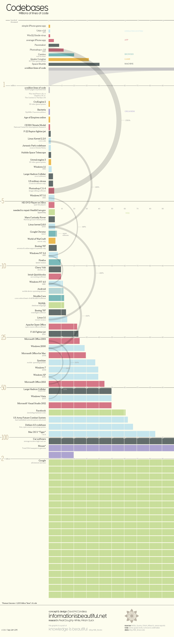
Problem: The Gap Between Academia & Industry

Slide 27
Scale of proof in verification

Slide 28
Super-linear scaling

Slide 29


Outline

Slide 30
Outline

Slide 31
Outline

Slide 32
Progress on the Problem: Fiat Cryptography
progress bar by LAFS from the Noun Project
Notes:
Misc Notes: Fiat Crypto first commit Sep 10, 2015
Fiat Crypto in Chrome Canary by Jan 2018

Slide 33

Fiat Cryptography: The Goal
Generate verified low-level cryptographic primitives
Where this is important:
Bank by akash k from the Noun Project
Chrome browser by Jan-Christoph Borchardt from the Noun Project
HTTPS image modified from image by Sean MacEntee, CC BY 2.0, via Wikimedia Commons
Notes:
Ini

Slide 34
Fiat Cryptography: The Goal
Generate verified low-level cryptographic primitives
Where this is important:
Bank by akash k from the Noun Project
Chrome browser by Jan-Christoph Borchardt from the Noun Project
HTTPS image modified from image by Sean MacEntee, CC BY 2.0, via Wikimedia Commons

Slide 35
Fiat Cryptography: Desiderata
Code we verify must be fast and constant time
Justification: server load, security
Easy to add and prove new algorithm, prime, architecture, …
Justification: scalability of human effort, edit-compile-debug loops
Coq should not run forever
Justification: Obvious
Notes:
Alternate 3rd: Verification should complete in reasonable time
Alternate 3rd justification: Needs to be checkable in time for industry deadlines, in time to be usable

Slide 36
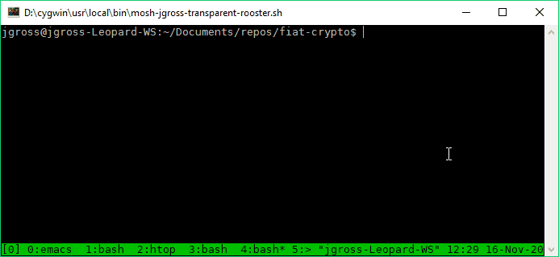
Spoiler: It Works Great!
Notes:
Our output artifact is actually pretty cool, and can automatically generate basically verified code on the command line, in seconds (not hours or days or weeks), for given just the prime, the bitwidth, and the name of the high-level algorithm

Slide 37
Fiat Cryptography: Methodology
Associational
Columns
Montgomery
Freeze
Bounds Analysis
Positional
Rows
Barrett
Base Conversion
Partial Evaluation
Notes:
$ find src/Arithmetic -name "*.v" | xargs coqwc | sort -h
spec proof comments
27 68 0 src/Arithmetic/CoreExtra.v
29 75 1 src/Arithmetic/Primitives.v
32 40 0 src/Arithmetic/SaturatedAssociational.v
37 77 3 src/Arithmetic/FancyMontgomeryReduction.v
39 39 36 src/Arithmetic/BarrettReduction/Wikipedia.v
49 53 38 src/Arithmetic/BarrettReduction/HAC.v
52 71 3 src/Arithmetic/Partition.v
53 75 1 src/Arithmetic/ModularArithmeticPre.v
58 133 2 src/Arithmetic/UniformWeight.v
62 99 38 src/Arithmetic/BarrettReduction/Generalized.v
69 0 91 src/Arithmetic/MontgomeryReduction/Definition.v
70 163 37 src/Arithmetic/PrimeFieldTheorems.v
102 152 4 src/Arithmetic/MontgomeryReduction/Proofs.v
104 172 65 src/Arithmetic/BarrettReduction/RidiculousFish.v
134 177 12 src/Arithmetic/ModularArithmeticTheorems.v
150 109 9 src/Arithmetic/SaturatedColumns.v
181 135 14 src/Arithmetic/Freeze.v
181 31 3 src/Arithmetic/ModOps.v
197 335 14 src/Arithmetic/BarrettReduction.v
215 145 58 src/Arithmetic/CoreAssociational.v
225 101 21 src/Arithmetic/BaseConversion.v
266 198 14 src/Arithmetic/CorePositional.v
357 503 50 src/Arithmetic/BYInv.v
366 243 25 src/Arithmetic/SaturatedRows.v
482 721 12 src/Arithmetic/WordByWordMontgomery.v
512 407 72 src/Arithmetic/Core.v
552 409 34 src/Arithmetic/Saturated.v
4601 4731 657 total
$ git ls-files "*.v" | grep -v Util | grep -v Demo | xargs coqwc | sort -h
spec proof comments
5 152 3 src/Rewriter/Language/IdentifiersGenerateProofs.v
9 0 0 src/Rewriter/Rewriter/Examples/PerfTesting/Settings.v
9 10 0 src/Rewriter/Rewriter/Examples/PerfTesting/ListRectInstances.v
16 109 0 src/Rewriter/Language/IdentifiersBasicLibrary.v
18 705 39 src/Rewriter/Language/IdentifiersGenerate.v
23 0 3 src/Rewriter/Language/PreCommon.v
23 539 15 src/Rewriter/Rewriter/ProofsCommonTactics.v
24 1524 12 src/Rewriter/Language/IdentifiersBasicGenerate.v
44 33 0 src/Rewriter/Language/PreLemmas.v
58 15 0 src/Rewriter/Rewriter/Examples/PrefixSums.v
66 3 3 src/Rewriter/Rewriter/Examples.v
73 0 6 src/Rewriter/Language/Pre.v
138 191 41 src/Rewriter/Rewriter/Examples/PerfTesting/LiftLetsMap.v
142 12 40 src/Rewriter/Rewriter/Examples/PerfTesting/UnderLetsPlus0.v
171 208 14 src/Rewriter/Rewriter/AllTactics.v
187 320 22 src/Rewriter/Language/IdentifiersLibraryProofs.v
203 5 47 src/Rewriter/Rewriter/Examples/PerfTesting/SieveOfEratosthenes.v
238 0 4 src/Rewriter/Language/UnderLets.v
273 71 8 src/Rewriter/Rewriter/Examples/PerfTesting/Harness.v
299 3 117 src/Rewriter/Rewriter/Examples/PerfTesting/Plus0Tree.v
543 442 15 src/Rewriter/Rewriter/Wf.v
582 275 26 src/Rewriter/Language/IdentifiersLibrary.v
662 875 8 src/Rewriter/Rewriter/InterpProofs.v
780 299 0 src/Rewriter/Language/Inversion.v
900 17 54 src/Rewriter/Rewriter/Examples/PerfTesting/Sample.v
962 946 22 src/Rewriter/Language/Wf.v
1015 141 24 src/Rewriter/Rewriter/Reify.v
1220 676 6 src/Rewriter/Language/UnderLetsProofs.v
1310 95 68 src/Rewriter/Rewriter/Rewriter.v
1630 138 96 src/Rewriter/Language/Language.v
1813 1908 31 src/Rewriter/Rewriter/ProofsCommon.v
13436 9712 724 total
$ git ls-files 'src/AbstractInterpretation/*.v' | xargs coqwc
spec proof comments
519 0 23 src/AbstractInterpretation/AbstractInterpretation.v
697 763 1 src/AbstractInterpretation/Proofs.v
452 679 8 src/AbstractInterpretation/Wf.v
24 0 0 src/AbstractInterpretation/WfExtra.v
736 65 25 src/AbstractInterpretation/ZRange.v
276 354 2 src/AbstractInterpretation/ZRangeProofs.v
2704 1861 59 total

Slide 38
Fiat Cryptography: Methodology
Bounds Analysis
Associational
Columns
Montgomery
Freeze
Partial Evaluation
Positional
Rows
Base Conversion
Barrett
Notes:
Bounds Analysis and Partial Evaluation are the two components that break all the abstraction barriers, and therefore have to be done reflectively
$ find src/Arithmetic -name "*.v" | xargs coqwc | sort -h
spec proof comments
27 68 0 src/Arithmetic/CoreExtra.v
29 75 1 src/Arithmetic/Primitives.v
32 40 0 src/Arithmetic/SaturatedAssociational.v
37 77 3 src/Arithmetic/FancyMontgomeryReduction.v
39 39 36 src/Arithmetic/BarrettReduction/Wikipedia.v
49 53 38 src/Arithmetic/BarrettReduction/HAC.v
52 71 3 src/Arithmetic/Partition.v
53 75 1 src/Arithmetic/ModularArithmeticPre.v
58 133 2 src/Arithmetic/UniformWeight.v
62 99 38 src/Arithmetic/BarrettReduction/Generalized.v
69 0 91 src/Arithmetic/MontgomeryReduction/Definition.v
70 163 37 src/Arithmetic/PrimeFieldTheorems.v
102 152 4 src/Arithmetic/MontgomeryReduction/Proofs.v
104 172 65 src/Arithmetic/BarrettReduction/RidiculousFish.v
134 177 12 src/Arithmetic/ModularArithmeticTheorems.v
150 109 9 src/Arithmetic/SaturatedColumns.v
181 135 14 src/Arithmetic/Freeze.v
181 31 3 src/Arithmetic/ModOps.v
197 335 14 src/Arithmetic/BarrettReduction.v
215 145 58 src/Arithmetic/CoreAssociational.v
225 101 21 src/Arithmetic/BaseConversion.v
266 198 14 src/Arithmetic/CorePositional.v
357 503 50 src/Arithmetic/BYInv.v
366 243 25 src/Arithmetic/SaturatedRows.v
482 721 12 src/Arithmetic/WordByWordMontgomery.v
512 407 72 src/Arithmetic/Core.v
552 409 34 src/Arithmetic/Saturated.v
4601 4731 657 total
$ git ls-files "*.v" | grep -v Util | grep -v Demo | xargs coqwc | sort -h
spec proof comments
5 152 3 src/Rewriter/Language/IdentifiersGenerateProofs.v
9 0 0 src/Rewriter/Rewriter/Examples/PerfTesting/Settings.v
9 10 0 src/Rewriter/Rewriter/Examples/PerfTesting/ListRectInstances.v
16 109 0 src/Rewriter/Language/IdentifiersBasicLibrary.v
18 705 39 src/Rewriter/Language/IdentifiersGenerate.v
23 0 3 src/Rewriter/Language/PreCommon.v
23 539 15 src/Rewriter/Rewriter/ProofsCommonTactics.v
24 1524 12 src/Rewriter/Language/IdentifiersBasicGenerate.v
44 33 0 src/Rewriter/Language/PreLemmas.v
58 15 0 src/Rewriter/Rewriter/Examples/PrefixSums.v
66 3 3 src/Rewriter/Rewriter/Examples.v
73 0 6 src/Rewriter/Language/Pre.v
138 191 41 src/Rewriter/Rewriter/Examples/PerfTesting/LiftLetsMap.v
142 12 40 src/Rewriter/Rewriter/Examples/PerfTesting/UnderLetsPlus0.v
171 208 14 src/Rewriter/Rewriter/AllTactics.v
187 320 22 src/Rewriter/Language/IdentifiersLibraryProofs.v
203 5 47 src/Rewriter/Rewriter/Examples/PerfTesting/SieveOfEratosthenes.v
238 0 4 src/Rewriter/Language/UnderLets.v
273 71 8 src/Rewriter/Rewriter/Examples/PerfTesting/Harness.v
299 3 117 src/Rewriter/Rewriter/Examples/PerfTesting/Plus0Tree.v
543 442 15 src/Rewriter/Rewriter/Wf.v
582 275 26 src/Rewriter/Language/IdentifiersLibrary.v
662 875 8 src/Rewriter/Rewriter/InterpProofs.v
780 299 0 src/Rewriter/Language/Inversion.v
900 17 54 src/Rewriter/Rewriter/Examples/PerfTesting/Sample.v
962 946 22 src/Rewriter/Language/Wf.v
1015 141 24 src/Rewriter/Rewriter/Reify.v
1220 676 6 src/Rewriter/Language/UnderLetsProofs.v
1310 95 68 src/Rewriter/Rewriter/Rewriter.v
1630 138 96 src/Rewriter/Language/Language.v
1813 1908 31 src/Rewriter/Rewriter/ProofsCommon.v
13436 9712 724 total
$ git ls-files 'src/AbstractInterpretation/*.v' | xargs coqwc
spec proof comments
519 0 23 src/AbstractInterpretation/AbstractInterpretation.v
697 763 1 src/AbstractInterpretation/Proofs.v
452 679 8 src/AbstractInterpretation/Wf.v
24 0 0 src/AbstractInterpretation/WfExtra.v
736 65 25 src/AbstractInterpretation/ZRange.v
276 354 2 src/AbstractInterpretation/ZRangeProofs.v
2704 1861 59 total

Slide 39
Fiat Cryptography: Methodology
Carve up the low-level code into neatly-separated conceptually distinct units that are small enough to not hit asymptotic issues during interactive verification
My colleagues did most of this, though I helped them see how factoring and abstraction impact performance of verification effort
TODO: describe abstraction in terms of excessive unfolding, either here or elsewhere
The remaining chunk is partial evaluation

Slide 40
Partial Evaluation and Rewriting

Slide 41
Partial Evaluation: What is it?
Describe it
Notes:
Partial evaluation is like: if you have instructions for making a peanut butter and jelly sandwich that start with “search the house for the peanut butter, the jelly and the bread”, and if you always keep them in the same place, rather than writing out instructions that start with “search the house”, you can instead write out instructions that start with “fetch the peanut butter from the top shelf of the pantry on the right”.
Notably, partial evaluation is partial; you can partially evaluation equations like x + 2 + y – x + 6 into y + 8 without knowing what y is.

Slide 42
Partial Evaluation: It’s not Trivial
# binders for:
Curve25519: 90 (x64) or 188 (x32)
P-256: 150 (x64) or 400 (x32)
P-384: 300 (x64) or 916 (x32)
Notes:
Note that it's too big to handle interactively with reasonable performance (include perf plots of rewrite)
Note that this is also only about when arithmetic simplification is involved (or code-sharing-preservation)
TODO: note something about topdown and bottomup being almost identical
The underlying reason for this chunk being hard is that all of the abstraction barriers that we introduced to carve the problem up into manageable chunks are broken here, so that we get fast low-level code out (this is a general pattern around performant code)
A large chunk of my PhD work was making this possible in a way that scales
UnderLetsPlus0

Slide 43
Partial Evaluation and Rewriting: Requirements
β-reduction
ιδ-reduction + rewrites
code sharing preservation

Slide 44
Partial Evaluation and Rewriting: Requirements: β-reduction
Example of β-reduction with ((\lambda x. x + 5) 2)
Words about how termination is non-trivial and interesting
Note that this is useful for eliminating function call overhead in the generated code, with is important for output code performance

Slide 45
Partial Evaluation and Rewriting: Requirements: ιδ-reduction + rewrites
Example of ιδ-reduction + rewrites with (map (\lambda x. x + 5) [1; 2; 3])
Note that this leaves β redexes
Words about how making rewriting efficient and combining it with β-reduction in a way that scales is interesting (idk what to say here though)
Words for arithmetic rewriting in fiat-crypto: without this we get quartic asymptotics of the # lines of code rather than merely quadratic, so it's not really acceptable to save for a later stage
Notes:
TODO: talk about and represent case analysis + recursion + function body inlining

Slide 46
Partial Evaluation and Rewriting: Requirements: Code Sharing Preservation
Example of let-lifting with (map f (let y := x + x in let z := y + y in [z; z; z])
to avoid exponential blowup in code size

Slide 47
Partial Evaluation and Rewriting: Requirements
β-reduction
eliminating function call overhead
ιδ-reduction + rewrites
inlining definitions to eliminate function call overhead
arithmetic simplification
code sharing preservation
to avoid exponential blowup in code size
Notes:
Note for ιδ-reduction + rewrites: without this we get quartic asymptotics of the # lines of code rather than merely quadratic, so it's not really acceptable to save for a later stage

Slide 48
Partial Evaluation and Rewriting: Extra Obvious Requirements
Verified
Without extending the TCB
Performant
should not introduce extra super-linear factors
Notes:
On performant: note that we don't quite manage this one, but we do a lot better than the interactive solutions

Slide 49
Partial Evaluation and Rewriting: Implementation
Reflective so as to not extend the TCB and to perform fast enough
Side benefit: we can extract it to OCaml to run as a nifty command-line utility
Normalization by Evaluation (NbE) (for β) + let-lifting (code-sharing) + rewriting (ιδ+rewrite)
Note that we use some tricks for speeding up rewriting such as pattern-matching compilation, on-the-fly emitting identifier codes so that we can use Coq's/OCaml's pattern matching compiler, pre-evaluating the rewriter itself
TODO: Spend some slides talking about these
TODO: how much of this do I throw up ahead of time???

Slide 50
Partial Evaluation and Rewriting: Implementation
Reflective so as to not extend the TCB and to perform fast enough
Side benefit: we can extract it to OCaml to run as a nifty command-line utility
Talk about what reflection is, small TCB of Coq, checks proofs, interactive steps leave behind large proofs to justify their work. (Talk about how reflection is about verifying the process, rather than having an ad-hoc process that leaves behind a trail verifying the output. This is actually asymptotically faster in some cases such as rewriting because the trail of verification, unless done very cleverly, involves super-linear duplication of the term being rewritten. Also, proof building in Coq is so slow in general, both the asymptotics and to a lesser extent the constant factors, that even when we have to run the whole process again at Qed-time, reflection still comes out massively ahead, performance-wise

Slide 51
Partial Evaluation and Rewriting: Implementation: Normalization by Evaluation
Normalization by Evaluation (NbE) is for β
Pull slides from RQE???
Expression application ⇝ Gallina application
Expression abstraction ⇝ Gallina abstraction
Expression constants ⇝ rewriter invocations on η-expanded forms

Slide 52
Partial Evaluation and Rewriting: Implementation: Normalization by Evaluation
Goal: Reuse substitution in Gallina for substitution in ASTs
Notes:
TODO: fuse this with next two slides

Slide 53
Partial Evaluation and Rewriting: Implementation: Normalization by Evaluation
Goal: Reuse substitution in Gallina for substitution in ASTs
Example: Turn “(λ z p n x. z + (x + (p + n))) 0 1 (-1)” into
(λ z p n x. (λ a b. rewrite(“+”, a, b))
z ((λ a b. rewrite(“+”, a, b))
x ((λ a b. rewrite(“+”, a, b))
p n)))) (rewrite(“0”)) (rewrite(“1”)) (rewrite(“-1”))
Notes:
Say: everything not in quotes is Gallina, quoted things are AST in a deeply embedded language

Slide 54
Partial Evaluation and Rewriting: Implementation: Normalization by Evaluation
Goal: Reuse substitution in Gallina for substitution in ASTs
Example: Turn “(λ z p n x. z + (x + (p + n))) 0 1 (-1)” into
(λ z p n x. (λ a b. rewrite(“+”, a, b))
z ((λ a b. rewrite(“+”, a, b))
x ((λ a b. rewrite(“+”, a, b))
p n)))) (rewrite(“0”)) (rewrite(“1”)) (rewrite(“-1”))
Expression application ⇝ Gallina application
Expression abstraction ⇝ Gallina abstraction
Expression constants ⇝ rewriter invocations on η-expanded forms
Notes:
In standard NbE, we just insert constant application at the leaves, rather than rewriter invocations. (Maybe emphasize this more)

Slide 55
Partial Evaluation and Rewriting: Implementation: Normalization by Evaluation
Goal: Reuse substitution in Gallina for substitution in ASTs
Example: Turn “(λ z p n x. z + (x + (p + n))) 0 1 (-1)” into
(λ z p n x. (λ a b. rewrite(“+”, a, b))
z ((λ a b. rewrite(“+”, a, b))
x ((λ a b. rewrite(“+”, a, b))
p n)))) (rewrite(“0”)) (rewrite(“1”)) (rewrite(“-1”))
Then reduce!

Slide 56
Partial Evaluation and Rewriting: Implementation: Let-Lifting
For code-sharing-preservation
Some words about LetIn monad
Some words about re-doing NbE in the LetIn monad, which is like the CPS monad
Haven’t seen it in the literature, but it’s not too tricky

Slide 57
Partial Evaluation and Rewriting: Implementation: Rewriting
For ιδ+rewrite
Perhaps the most interesting component is that fusing rewriting with NbE in PHOAS allows us to delay rewriting and achieve complete rewriting in a single pass when the rewrite rules form a DAG
(We have extra magic for when they don’t. The magic is called “fuel” and “try again”.)

Slide 58
Partial Evaluation and Rewriting: Implementation: Rewriting: More Features
We select which rewrite rule to use based on Coq’s pattern matching, which means that we don’t need to walk the entire list of rewrite rules at every identifier/constant node just to see which ones apply
We enable this efficiency by on-the-fly emission of a type of codes for the constants we care about (seems like a new way of doing things not present elsewhere in the literature)
We further gain efficiency (about 2x) by doing partial evaluation on the generated rewriter itself (using Coq’s built-in mechanisms)
Notes:
Using extracted code: pattern-matching compilation gives approximately 4x speedup over naive strategy, + another 2x if we pre-reduce the rewriter (which OOMs if we don’t use pattern matching compilation (quadratic code size in # of rewrite rules? (approximately due to encoding artifacts (ι-expansion of head symbol)))

Slide 59
Partial Evaluation and Rewriting: Implementation
Reflective so as to not extend the TCB and to perform fast enough
Side benefit: we can extract it to OCaml to run as a nifty command-line utility
Normalization by Evaluation (NbE) (for β) + let-lifting (code-sharing) + rewriting (ιδ+rewrite)
Note that we use some tricks for speeding up rewriting such as pattern-matching compilation, on-the-fly emitting identifier codes so that we can use Coq's/OCaml's pattern matching compiler, pre-evaluating the rewriter itself
TODO: Spend some slides talking about these
Notes:
Note: speech for let-lifting: involves redoing NbE in a let-lifting monad (similar to the CPS monad). Only slightly tricky, but details are too complex to get into the nuance here

Slide 60
Partial Evaluation and Rewriting: Evaluation
It works!
It's performant!
It seems like it would also solve one of the two performance issues that killed the parser-synthesizer I worked on for my masters.

Slide 61
Partial Evaluation and Rewriting: Performance
# binders for:
Curve25519: 90 (x64) or 188 (x32)
P-256: 150 (x64) or 400 (x32)
P-384: 300 (x64) or 916 (x32)
Notes:
Note that it's too big to handle interactively with reasonable performance (include perf plots of rewrite)
The underlying reason for this chunk being hard is that all of the abstraction barriers that we introduced to carve the problem up into manageable chunks are broken here, so that we get fast low-level code out (this is a general pattern around performant code)
A large chunk of my PhD work was making this possible in a way that scales
UnderLetsPlus0

Slide 62


Outline

Slide 63
Outline

Slide 64
Outline

Slide 65
Takeaways: What’s Working
Image success by Gregor Cresnar from the Noun Project (CCBY) has been modified

Slide 66
Takeaways
Asymptotic scaling of interactive proof assistant response is a real problem!
Current method---of working around it by breaking the problem into small enough chunks and solving remaining chunks with specialized reflective solutions---does seem to work.
I'm not optimistic about being able to break things down enough to handle them all interactively; even in very abstract math (category theory), I ran into issues where the way mathematicians did it was not sufficient. Furthermore basically all code that needs to be fast, and a great deal of systems code, inlines definitions in a way that causes performance issues.
And reflective automation requires enormous investment of effort for each new problem.
Because reflection is not a proof engine made of small pieces that can each be said to make progress towards proving a goal, it's not easy to mix-and-match.
I needed let-lifting; prior work had already done NbE and reflective rewriting, but fusing them with let-lifting in a performant way seems to have required re-engineering them almost from scratch.

Slide 67

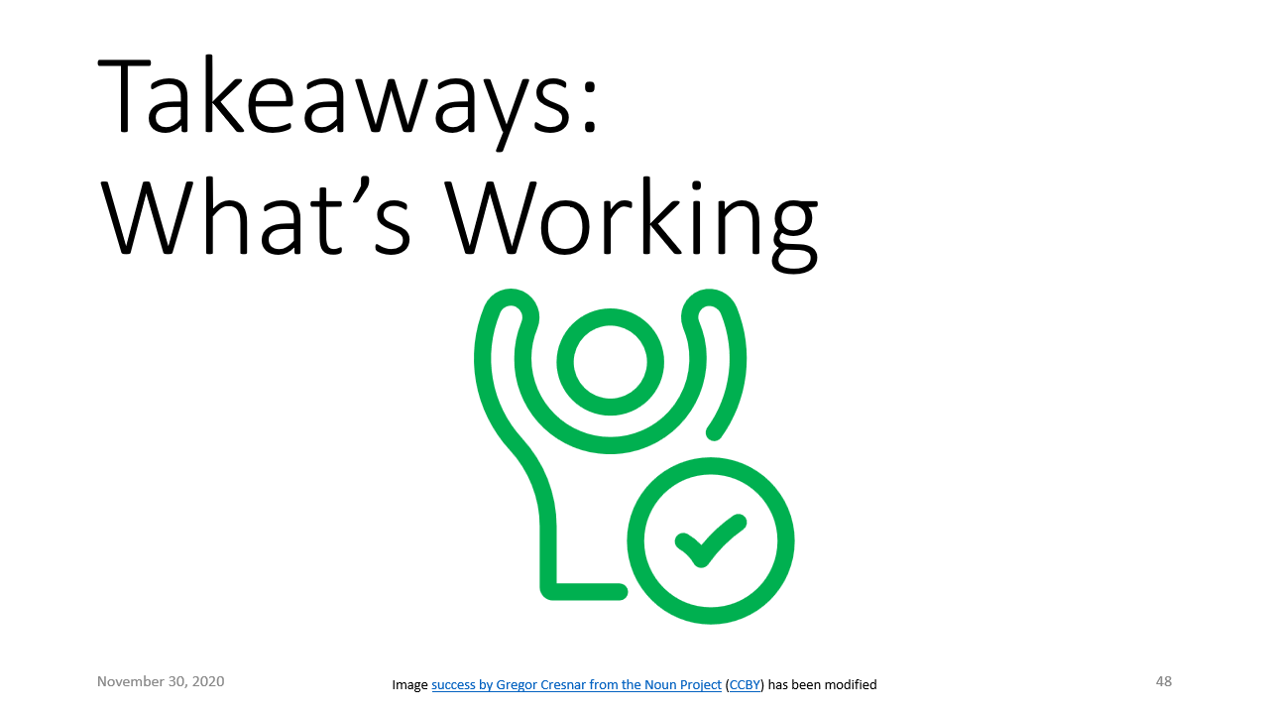
Outline

Slide 68
Outline

Slide 69
Outline

Slide 70
Takeaways: What Needs to Change
Image Settings by Sebastian Belalcazar Lareo from the Noun Project (CCBY) has been modified

Slide 71
Takeaways: What Needs to Change
Does it have to be this way?
No! (I hope)
No one seems to be studying why proof engines are asymptotically slow!
It's not just accident; there are good reasons that obvious solutions have the wrong asymptotics, and there's so much going on that it's not even clear yet what the specification of "adequate performance" is.
I think solving this problem---getting the basics right, asymptotically---will drastically accelerate the scale of what we as a field can handle, and bring verification closer to it's promise and potential.

Slide 72
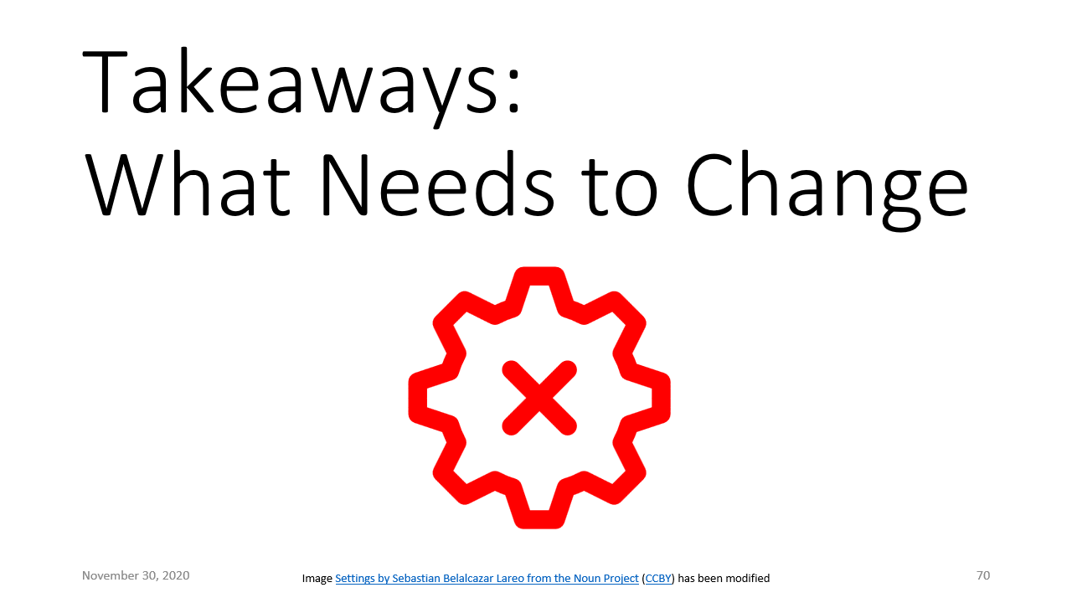
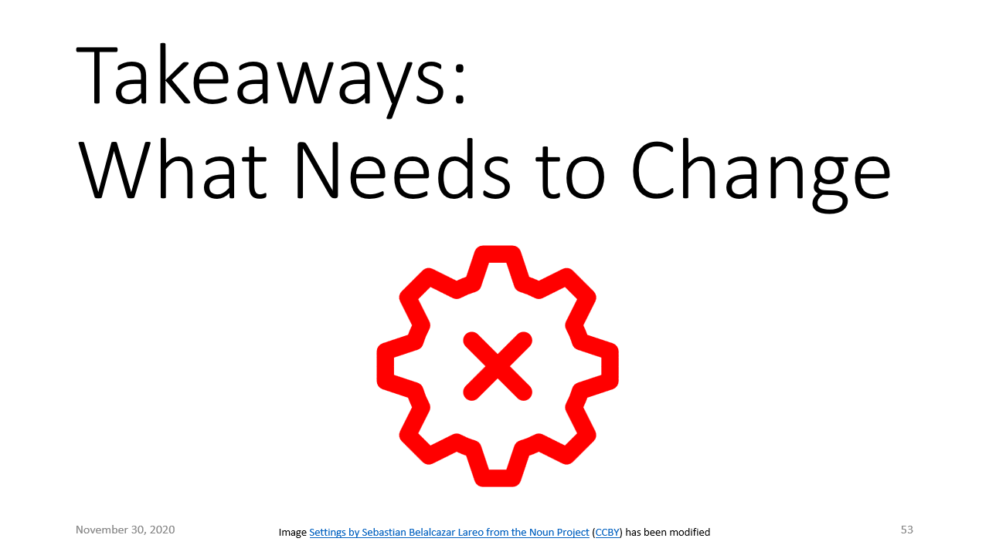
Outline

Slide 73

Outline

Slide 74
Q & A

Slide 75
Thank you for your time and attention!
Questions?

Slide 76
Fiat Cryptography: Methodology
Bounds Analysis
Montgomery
Associational
Columns
Freeze
Partial Evaluation
Positional
Rows
Base Conversion
Barrett
Notes:
$ find src/Arithmetic -name "*.v" | xargs coqwc | sort -h
spec proof comments
27 68 0 src/Arithmetic/CoreExtra.v
29 75 1 src/Arithmetic/Primitives.v
32 40 0 src/Arithmetic/SaturatedAssociational.v
37 77 3 src/Arithmetic/FancyMontgomeryReduction.v
39 39 36 src/Arithmetic/BarrettReduction/Wikipedia.v
49 53 38 src/Arithmetic/BarrettReduction/HAC.v
52 71 3 src/Arithmetic/Partition.v
53 75 1 src/Arithmetic/ModularArithmeticPre.v
58 133 2 src/Arithmetic/UniformWeight.v
62 99 38 src/Arithmetic/BarrettReduction/Generalized.v
69 0 91 src/Arithmetic/MontgomeryReduction/Definition.v
70 163 37 src/Arithmetic/PrimeFieldTheorems.v
102 152 4 src/Arithmetic/MontgomeryReduction/Proofs.v
104 172 65 src/Arithmetic/BarrettReduction/RidiculousFish.v
134 177 12 src/Arithmetic/ModularArithmeticTheorems.v
150 109 9 src/Arithmetic/SaturatedColumns.v
181 135 14 src/Arithmetic/Freeze.v
181 31 3 src/Arithmetic/ModOps.v
197 335 14 src/Arithmetic/BarrettReduction.v
215 145 58 src/Arithmetic/CoreAssociational.v
225 101 21 src/Arithmetic/BaseConversion.v
266 198 14 src/Arithmetic/CorePositional.v
357 503 50 src/Arithmetic/BYInv.v
366 243 25 src/Arithmetic/SaturatedRows.v
482 721 12 src/Arithmetic/WordByWordMontgomery.v
512 407 72 src/Arithmetic/Core.v
552 409 34 src/Arithmetic/Saturated.v
4601 4731 657 total
$ git ls-files "*.v" | grep -v Util | grep -v Demo | xargs coqwc | sort -h
spec proof comments
5 152 3 src/Rewriter/Language/IdentifiersGenerateProofs.v
9 0 0 src/Rewriter/Rewriter/Examples/PerfTesting/Settings.v
9 10 0 src/Rewriter/Rewriter/Examples/PerfTesting/ListRectInstances.v
16 109 0 src/Rewriter/Language/IdentifiersBasicLibrary.v
18 705 39 src/Rewriter/Language/IdentifiersGenerate.v
23 0 3 src/Rewriter/Language/PreCommon.v
23 539 15 src/Rewriter/Rewriter/ProofsCommonTactics.v
24 1524 12 src/Rewriter/Language/IdentifiersBasicGenerate.v
44 33 0 src/Rewriter/Language/PreLemmas.v
58 15 0 src/Rewriter/Rewriter/Examples/PrefixSums.v
66 3 3 src/Rewriter/Rewriter/Examples.v
73 0 6 src/Rewriter/Language/Pre.v
138 191 41 src/Rewriter/Rewriter/Examples/PerfTesting/LiftLetsMap.v
142 12 40 src/Rewriter/Rewriter/Examples/PerfTesting/UnderLetsPlus0.v
171 208 14 src/Rewriter/Rewriter/AllTactics.v
187 320 22 src/Rewriter/Language/IdentifiersLibraryProofs.v
203 5 47 src/Rewriter/Rewriter/Examples/PerfTesting/SieveOfEratosthenes.v
238 0 4 src/Rewriter/Language/UnderLets.v
273 71 8 src/Rewriter/Rewriter/Examples/PerfTesting/Harness.v
299 3 117 src/Rewriter/Rewriter/Examples/PerfTesting/Plus0Tree.v
543 442 15 src/Rewriter/Rewriter/Wf.v
582 275 26 src/Rewriter/Language/IdentifiersLibrary.v
662 875 8 src/Rewriter/Rewriter/InterpProofs.v
780 299 0 src/Rewriter/Language/Inversion.v
900 17 54 src/Rewriter/Rewriter/Examples/PerfTesting/Sample.v
962 946 22 src/Rewriter/Language/Wf.v
1015 141 24 src/Rewriter/Rewriter/Reify.v
1220 676 6 src/Rewriter/Language/UnderLetsProofs.v
1310 95 68 src/Rewriter/Rewriter/Rewriter.v
1630 138 96 src/Rewriter/Language/Language.v
1813 1908 31 src/Rewriter/Rewriter/ProofsCommon.v
13436 9712 724 total
$ git ls-files 'src/AbstractInterpretation/*.v' | xargs coqwc
spec proof comments
519 0 23 src/AbstractInterpretation/AbstractInterpretation.v
697 763 1 src/AbstractInterpretation/Proofs.v
452 679 8 src/AbstractInterpretation/Wf.v
24 0 0 src/AbstractInterpretation/WfExtra.v
736 65 25 src/AbstractInterpretation/ZRange.v
276 354 2 src/AbstractInterpretation/ZRangeProofs.v
2704 1861 59 total

Slide 77
Fiat Cryptography: Methodology
Bounds Analysis
Montgomery
Associational
Columns
Freeze
Partial Evaluation
Positional
Rows
Base Conversion
Barrett
Notes:
$ find src/Arithmetic -name "*.v" | xargs coqwc | sort -h
spec proof comments
27 68 0 src/Arithmetic/CoreExtra.v
29 75 1 src/Arithmetic/Primitives.v
32 40 0 src/Arithmetic/SaturatedAssociational.v
37 77 3 src/Arithmetic/FancyMontgomeryReduction.v
39 39 36 src/Arithmetic/BarrettReduction/Wikipedia.v
49 53 38 src/Arithmetic/BarrettReduction/HAC.v
52 71 3 src/Arithmetic/Partition.v
53 75 1 src/Arithmetic/ModularArithmeticPre.v
58 133 2 src/Arithmetic/UniformWeight.v
62 99 38 src/Arithmetic/BarrettReduction/Generalized.v
69 0 91 src/Arithmetic/MontgomeryReduction/Definition.v
70 163 37 src/Arithmetic/PrimeFieldTheorems.v
102 152 4 src/Arithmetic/MontgomeryReduction/Proofs.v
104 172 65 src/Arithmetic/BarrettReduction/RidiculousFish.v
134 177 12 src/Arithmetic/ModularArithmeticTheorems.v
150 109 9 src/Arithmetic/SaturatedColumns.v
181 135 14 src/Arithmetic/Freeze.v
181 31 3 src/Arithmetic/ModOps.v
197 335 14 src/Arithmetic/BarrettReduction.v
215 145 58 src/Arithmetic/CoreAssociational.v
225 101 21 src/Arithmetic/BaseConversion.v
266 198 14 src/Arithmetic/CorePositional.v
357 503 50 src/Arithmetic/BYInv.v
366 243 25 src/Arithmetic/SaturatedRows.v
482 721 12 src/Arithmetic/WordByWordMontgomery.v
512 407 72 src/Arithmetic/Core.v
552 409 34 src/Arithmetic/Saturated.v
4601 4731 657 total
$ git ls-files "*.v" | grep -v Util | grep -v Demo | xargs coqwc | sort -h
spec proof comments
5 152 3 src/Rewriter/Language/IdentifiersGenerateProofs.v
9 0 0 src/Rewriter/Rewriter/Examples/PerfTesting/Settings.v
9 10 0 src/Rewriter/Rewriter/Examples/PerfTesting/ListRectInstances.v
16 109 0 src/Rewriter/Language/IdentifiersBasicLibrary.v
18 705 39 src/Rewriter/Language/IdentifiersGenerate.v
23 0 3 src/Rewriter/Language/PreCommon.v
23 539 15 src/Rewriter/Rewriter/ProofsCommonTactics.v
24 1524 12 src/Rewriter/Language/IdentifiersBasicGenerate.v
44 33 0 src/Rewriter/Language/PreLemmas.v
58 15 0 src/Rewriter/Rewriter/Examples/PrefixSums.v
66 3 3 src/Rewriter/Rewriter/Examples.v
73 0 6 src/Rewriter/Language/Pre.v
138 191 41 src/Rewriter/Rewriter/Examples/PerfTesting/LiftLetsMap.v
142 12 40 src/Rewriter/Rewriter/Examples/PerfTesting/UnderLetsPlus0.v
171 208 14 src/Rewriter/Rewriter/AllTactics.v
187 320 22 src/Rewriter/Language/IdentifiersLibraryProofs.v
203 5 47 src/Rewriter/Rewriter/Examples/PerfTesting/SieveOfEratosthenes.v
238 0 4 src/Rewriter/Language/UnderLets.v
273 71 8 src/Rewriter/Rewriter/Examples/PerfTesting/Harness.v
299 3 117 src/Rewriter/Rewriter/Examples/PerfTesting/Plus0Tree.v
543 442 15 src/Rewriter/Rewriter/Wf.v
582 275 26 src/Rewriter/Language/IdentifiersLibrary.v
662 875 8 src/Rewriter/Rewriter/InterpProofs.v
780 299 0 src/Rewriter/Language/Inversion.v
900 17 54 src/Rewriter/Rewriter/Examples/PerfTesting/Sample.v
962 946 22 src/Rewriter/Language/Wf.v
1015 141 24 src/Rewriter/Rewriter/Reify.v
1220 676 6 src/Rewriter/Language/UnderLetsProofs.v
1310 95 68 src/Rewriter/Rewriter/Rewriter.v
1630 138 96 src/Rewriter/Language/Language.v
1813 1908 31 src/Rewriter/Rewriter/ProofsCommon.v
13436 9712 724 total
$ git ls-files 'src/AbstractInterpretation/*.v' | xargs coqwc
spec proof comments
519 0 23 src/AbstractInterpretation/AbstractInterpretation.v
697 763 1 src/AbstractInterpretation/Proofs.v
452 679 8 src/AbstractInterpretation/Wf.v
24 0 0 src/AbstractInterpretation/WfExtra.v
736 65 25 src/AbstractInterpretation/ZRange.v
276 354 2 src/AbstractInterpretation/ZRangeProofs.v
2704 1861 59 total

